Slide 1
Introduction to Hypnosis

Slide 2
Definition of Hypnosis:
A natural yet altered state where the critical factor is relaxed and focused attention is maintained.

Slide 3
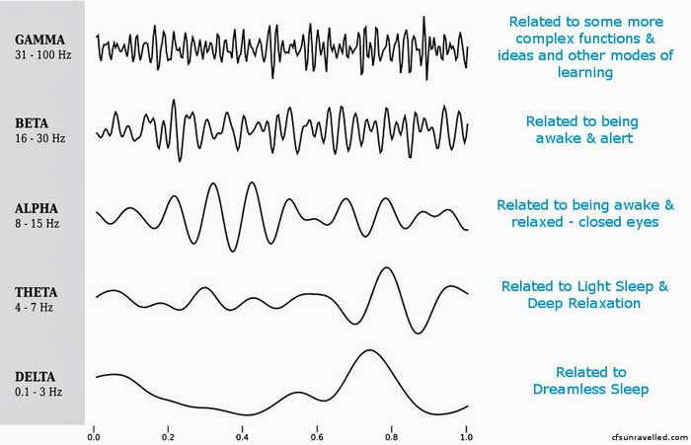
Brain Wave Activity

Slide 4
The Human Mind
Conscious Mind
Conscious Mind
Critical Factor
Sub-conscious Mind
Higher/Super
conscious

Slide 5
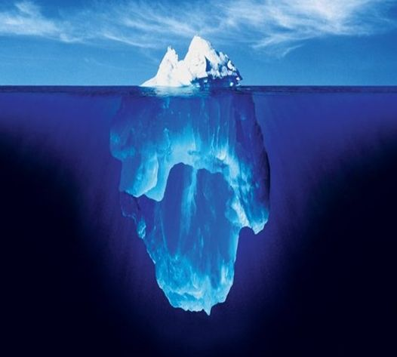
The Conscious Mind Processes
Reasoning
Will Power/intention
Logic
Sensory input
Deduction
Analysis
Choice
Intellect
Short term memory
Critical
Linear
Voluntary movement
Processes approximately .5 to 5% or 2000 bits of information in a given moment.

Slide 6
The Subconscious Mind Processes
Autonomic Nervous System
All memories/ long term
Beliefs
Emotions
Protection mechanism
Programmed to be right
Learns in pictures and metaphors
Associating mechanism/ sorts and files
Does not separate fact from fantasy/ literal
Creative intelligence
Never sleeps, always recording
Involuntary movement
Processes 5% to 95% of mental activity or approximately four billion bits of information in a given moment.
So which part of you is driving your bus???

Slide 7
The Autonomic Nervous System
Parasympathetic Nervous System vs Sympathetic Nervous System
Natural relaxed safe state Stress state: fight or flight
Body in homeostasis Imbalance
Supports immune system Suppresses immune system
Supports digestive system Suppresses digestive system
Supports reproductive system Suppresses reproductive system
Support brain function Decreases brain function
Hypnosis naturally activates the parasympathetic nervous system, creating balance and
homeostasis in the body. thus creating a state of healing by allowing blood flow and hormone balance to all systems in the body.

Slide 8
Superconscious
Infinite intelligence
Connection to your higher self
Connection to collective consciousness or
the Universal mind
Connection to God, spirit, guides, angels, etc.
Problem solving intelligence

Slide 9
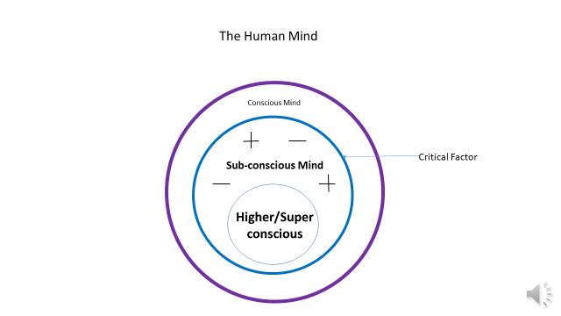
The Critical Factor
A critical gatekeeper. This mechanism either blocks or allows information to enter the unconscious. This mechanism develops around the age of seven.
In order to create change in the unconscious you must relax the critical factor.

Slide 10
Bypassing the Critical Factor
Information from an authority figure
Peers
Highly emotionalized state
Repetition
Altered state (hypnosis)

Slide 11
Facts and Fiction About Hypnosis
Can I get stuck in hypnosis? Fact: You cannot get stuck in hypnosis unless you want to.
I am afraid of losing consciousness (control). Fact: You do not lose consciousness. In fact, you can have your eyes open and talk while hypnotized. Levels of awareness during hypnosis will vary with the individual.
Can people be hypnotized and made to do or think things against their will? Fact: NO, the only way to make someone do something against their will is by brainwashing them. In some cases people can be hypnotized without their knowledge, however if they are aware that someone is trying to hypnotize them and they do not want to be hypnotized, they will not go into hypnosis.
Hypnosis has the same effect on the mind as meditation. The difference is that when we quiet the mind in hypnosis we work in the quiet space.

Slide 12
This presentation developed and presented by:
Becky Johnson, CMS-CHth
Integrated Health Dimensions
970-313-3253

